Slide 1
International Tourism
Presented by :
Presented to:

Slide 2
Introduction
International tourism allows people to visit foreign countries and learn about them.
Countries experience economic developments through tourism income.
Tourism is integral in boosting sectors of hospitality, transport and accommodation.
Transport sectors grow because tourists utilize air and sea transport to arrive to their tourist destinations.
Accommodation sectors enhance the safety of visitors during their tours.
Tourists cause positive economic outcomes.
Berlin, a City in Germany is an ideal case of exploring international tourism and understanding the concept.
Notes:
Tourism is integral in boosting sectors of hospitality, transport and accommodation. The hospitality industry ensures that the needs of visitors are fully addressed.Moreover; transport sectors grow because tourists utilize air and sea transport to arrive to their tourist destinations.Accomodation sectors enhance the safety of visitors during their tours (Wachowiak, 2016). Discussing Berlin City in Germany is essential in exploring international tourism and understanding the concept.

Slide 3
Why Berlin City?
The city has historic significance and rich cultural heritage.
Berlin has made significant contributions towards German’s historical development.
Berlin is Germany’s capital city.
Primary economic and political activities take place within the city.
Understanding Berlin’s history is necessary in promoting tourism in the country.
The division of Germany following the Second World War put Berlin under the territory of East Germany.
The wall of Berlin was restored with the city being declared as the capital following the downfall of Germany’s communist regime in 1989.
Notes:
Understanding Berlin’s history is necessary in promoting an exciting experience for tourists visiting the place.Apparently; the division of Germany after the Second World War put Berlin under the territory of East Germany (Bock, 2015).After the collapse of Germany’s communist regime in 1989, the wall of Berlin was reinstated with the city being declared as the capital. Berlin’s rich cultural heritage makes it an ideal place for tours.

Slide 4
Why Berlin City is an Ideal Tourist Destination
The city has several museums and numerous art galleries.
The city is popular for Berlin Philharmonic orchestra and the Berlin Opera.
Berlin is well-known for its significant contributions to science and research in innovative technologies.
Berlin is the most populous city with renowned scientists who discovered medicine.
Researchers, physicians and scientists have enhanced the study body cells and understand their working mechanisms.
Berlin enables visiting tourists to increases their knowledge base.
The city has numerous places to visit and learn.
Berlin seasonal temperate climate provides favorable atmospheric conditions for tourists.
Notes:
Being Germany’s capital, Berlin is the most populous city with renowned scientists who discovered medicine. Medical technological innovations in cellular pathology were influenced by Rudolf Virchow (Bock, 2015). Through the contributions of the scientist, physicians and researchers are able to study body cells and understand their working mechanisms. The selection of Berlin as a tourist destination increases the knowledge base of visiting individuals.

Slide 5
Selected Places to Visit
The Brandenburg Gate.
Museum Island
Charlottenburg Palace and Park
The Gendarmenmarkt
Jewish Museum
Grosser Tiergarten and the Victory Column
The Berlin Cathedral Church
Berlin-Dalhem Museum and Botanical Garden
Topography of Terror
Notes:
A prominent challenge with self-driving vehicles on public roads is the association and safe cooperation amongst many vehicles by means of inter-vehicle communications and sensor-based perception (Xhafa et al., 2018). Once self-driving vehicles attempt to occupy similar spatial area in a simultaneous manner, they may possibly, collide with each other, may be deadlocked, or may slam on the brakes rendering it unsafe or uncomfortable for self-driving vehicles’ passengers.

Slide 6
The Brandenburg Gate
The site depicted a nation that was divided during the Second World War.
The monument is made of sandstone with a height of twenty six meters
The site highlights the nature of Berlin during the period of the Cold War.
The gate’s design and structure is an inspiration from Propylaea from the Acropolis of Athens in Greece.
Tourists are able to learn that the gate played essential role in hosting demonstrations and protests from members within the western part of Berlin.
The monument’s history is important in understanding Berlin’s progress and prosperity following Cold War.
Notes:
The monument is made of sandstone with a height of twenty six meters (Berlin De Newsletter, n.d.).Tourists need to visit the place because it highlights the nature of Berlin during the period of the Cold War. The gate’s design and structure is an inspiration from Propylaea from the Acropolis of Athens in Greece (Berlin De Newsletter, n.d.). By visiting the place, tourists learn that the gate played essential functions in hosting demonstrations and protests from members within the western part of Berlin.

Slide 7
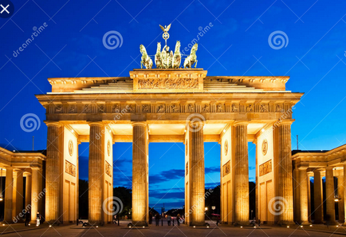
The Brandenburg Gate

Slide 8
Museum Island
Museum Island is recognized as the world’s heritage center located between Kupfergraben and River Spree.
The Island is important for hosting;
Altes Museum
The Neues Museum.
The Old Nation gallery.
The location promotes learning activities and increases knowledge scope on the leadership trends and systems in Germany.
Most artifacts stored within the museums provide great scientific evidence on activities that happened during ancient times.
The location consists of several collections such as Papyrus, the Egyptian museum and classical antiquities.
Tourists may view neoclassical paintings and sculptures from 1815-1848
Notes:
Most artifacts stored within the museums offer great scientific evidence on activities that occurred during the ancient times. The site has amazing places which comprise the new museum that was redone in 2009.Tourists get to see extensive collections from Papyrus, the Egyptian museum and classical antiquities (Planetware, n.d.). The existence of the old gallery offers a great opportunity for visitors to view neoclassical paintings and sculptures from 1815-1848.

Slide 9
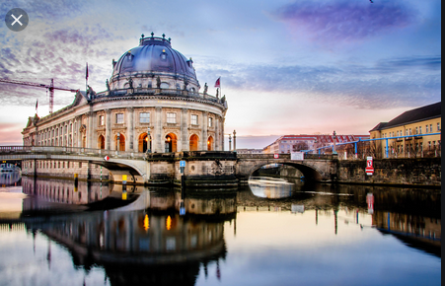
Museum Island

Slide 10
Charlottenburg Palace and Park
The location is considered as Berlin’s largest and oldest Prussian estate.
The site creates a picture of Germany during the seventeenth century.
The estate was considered a residential area for royal citizens in Germany.
Tourists are provided with beautiful and magnificent scenery.
Visitors can view massive central dome of about fifty meters with rococo décor within the park’s expansive rooms.
The large garden within the park takes the form of the garden of Versailles.
The park creates better opportunities for visitors to discover how Prussian kings and their electors lived during the ancient times.
The place offers a chance for visitors to see the golden gallery
Notes:
The place served as a residential area for royal citizens in Germany. The site was restored to form beautiful and magnificent scenery. Tourists visiting the place have the opportunity to see a massive central dome of about fifty meters with rococo décor within the park’s expansive rooms (Planetware, n.d.). The large garden existing within the park takes the form of the garden of Versailles. Tourists ought to see the place due to its rich cultural heritage and historical importance.

Slide 11
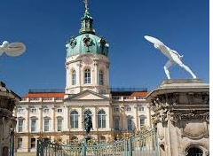
Charlottenburg Palace and Park

Slide 12
The Gendarmenmarkt
The site consists of three landmark buildings;
The German cathedral.
The French cathedral
Konzerthaus buildings
The square is a necessary place for hosting public ceremonies and celebrations.
The Konzerthaus structure is an important architectural masterpiece constructed during 1821.
The place offers a magnificent view to visitors who love music and orchestras.
The front part of the building highlights aspects of German philosophy, history and lyric poetry.
The French cathedral hosts the Huguenot museum.
Notes:
The location of Friedrich Schiller’s statue at the front part of the building highlights aspects of German philosophy, history and lyric poetry (Planetware, n.d.). Such factors make the destination a unique site for both students and tourists from other countries. Understanding a nation’s language, culture and linguistic elements is key. The French cathedral hosts the Huguenot museum while the German one provides a historical perspective of the parliament in Germany.

Slide 13
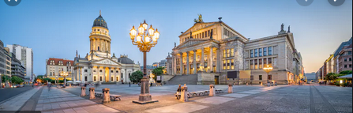
The Gendarmenmarkt

Slide 14
Significance of Berlin City
The city plays critical functions in the nation’s education and health.
Berlin offers a wide range of opportunities for the growth and development of learning institutions within Germany.
The location hosts famous universities, differentiated three track system schools and vocational training centers for both residents and non residents
The city hosts important medical facilities and institutions.
Berlin is highly developed with the most needed social amenities.
The city unites the east and western parts of Germany.
The city highlights a positive revolution in German’s leadership and the progress from the rule of the communists.
Notes:
Berlin highlights a historical significance to Germany in terms of it being a point of contention between the eastern and western parts of the country. The location was an essential place to both western and eastern powers participating in the cold war (Bock, 2015). Apparently, for the Germans, the capital is integral and symbolic because it largely contributed to a peaceful coexistence between residents. Such factors make Berlin a unique city that progressed well after its destruction during the cold war.

Slide 15
Conclusion
The Brandenburg gate highlights notable changes in the history of Germany.
The museum island allows tourists to learn more about ancient civilizations in Berlin Germany.
The Charlottenburg palace provides visitors with an experience of the life of the royalty class that lived in Germany.
The Gendarmenmarkt and the Jewish museum are ideal touristic destinations due to their symbolic nature.
The Berlin Cathedral church provides the chance of studying world religions, power and spirituality.
Berlin’s botanical garden develops and educates researchers and tourists on the significance of different plant species.
The Dalhem museum offers the chance of studying different plant species while understanding their survival mechanisms.
Notes:
By visiting The Brandenburg gate, individuals comprehend why the landmark monument is important to the people of Berlin. The Bode museum within Museum Island has a collection of numerous byzantine art sculptures, medals and coins (Planetware, n.d.). The Charlottenburg palace and park was chosen since it gives visitors an experience of the life of the royalty class that lived in Germany. Selecting the Gendarmenmarkt and the Jewish museum was critical due to the symbolic nature of the two tourist attraction places. Berlin offers a great chance for residents and foreigners to interact and enjoy cultural events publicly.

Slide 16
References
Wachowiak, H. (Ed.). (2016). Tourism and borders: contemporary issues, policies and international research. Routledge.
Planetware. (n.d.). 15 Top-Rated Tourist Attractions in Berlin. Retrieved November 6, 2019, from https://www.planetware.com/tourist-attractions-/berlin-d-bn-ber.htm
Berlin De Newsletter. (n.d.). Brandenburg Gate. Retrieved November 6, 2019, from https://www.berlin.de/en/attractions-and-sights/3560266-3104052-brandenburg-gate.en.html.
Bock, K. (2015). The changing nature of city tourism and its possible implications for the future of cities. European Journal of Futures Research, 3(1), 20.
Notes:
Total lost time is represented by L, and is normally perceived as inter-green periods’ sum total. The critical volume is represented by CS, which is total sum of each lane’s critical phase volume. Phase flow rate’s reference sum is represented by RS exemplifying the theoretical maximum value that could be accommodated by the intersection. Finally, the critical volume for each phase is represented by C.

